Slide 1
Salmon vs STAR
04/25/2023
ANGSD Project Presentation
Mohith Arikatla
MS Computational Biology 24’

Slide 2
Project learning objectives
End-to-end NGS Data Analysis
Formulating and testing a strategy
Learn to manage and process sequencing data
Evaluate the quality of the data at all stages
Interpret results
Document the process (with an emphasis on reproducibility)

Slide 3
The Question
Hypothesis: There will be a significant difference in the enriched pathways when different quantification algorithms are used. (Classical alignment vs Pseudo-mapping Algorithm)
Method: Obtain feature count data using an alignment algorithm and a pseudo-mapping algorithm and process them in the same way to perform pathway analysis and then compare the enriched pathways

Slide 4
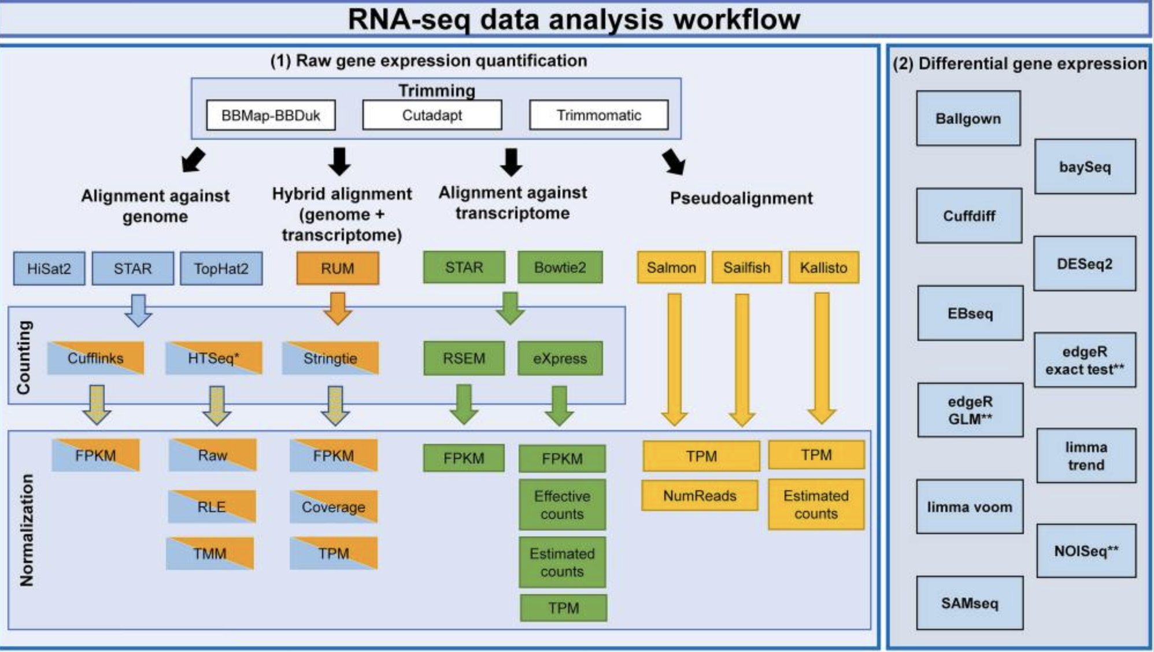
Decisions Decisions
Which pipeline do I use?
How long do you have?
What is your end goal?
Corchete et al., 2020
Notes:
Corchete LA, Rojas EA, Alonso-López D, De Las Rivas J, Gutiérrez NC, Burguillo FJ. Systematic comparison and assessment of RNA-seq procedures for gene expression quantitative analysis. Sci Rep. 2020;10(1):19737. Published 2020 Nov 12. doi:10.1038/s41598-020-76881-x

Slide 5
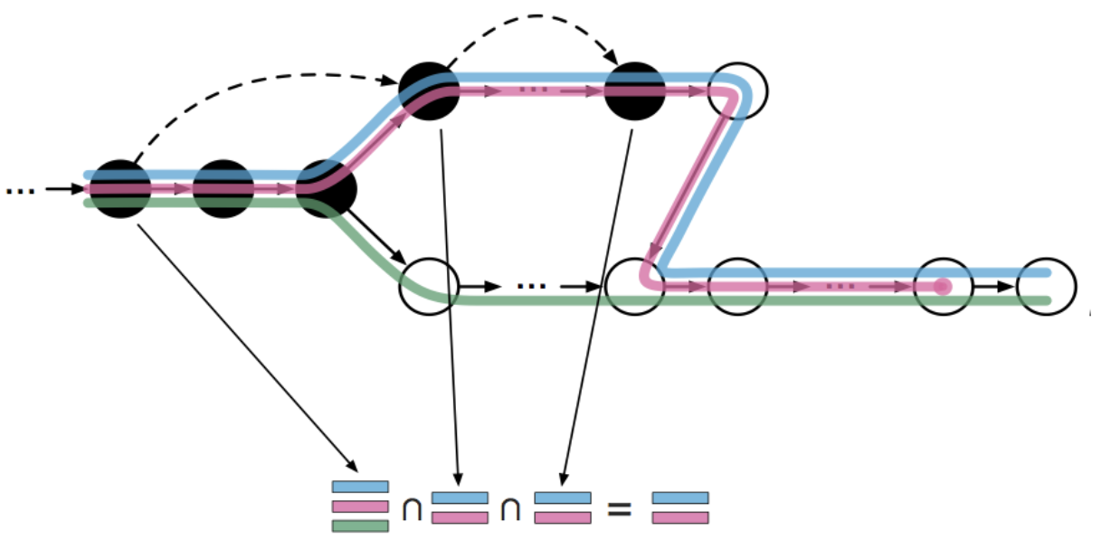
What is pseudo-alignment?
It’s NOT necessary to do a full alignment of the reads to the genome which is often the slowest step in sequencing analysis
Instead, the raw sequence reads are directly compared to transcript sequences and then used to quantify transcript abundance
Pseudo-aligners have an advantage in terms of the time of computation through skipping redundant hash-mappings
https://tinyheero.github.io/2015/09/02/pseudoalignments-kallisto.html

Slide 6
Comparison
Feature | Salmon | STAR
Genome Reference |  | x
Transcriptome Reference | x | x
Needs annotation | x
Alignment |  | x
Pseudo-alignment (Only quantification) | x | x
Expression Values | x | x
Splice aware |  | x

Slide 7
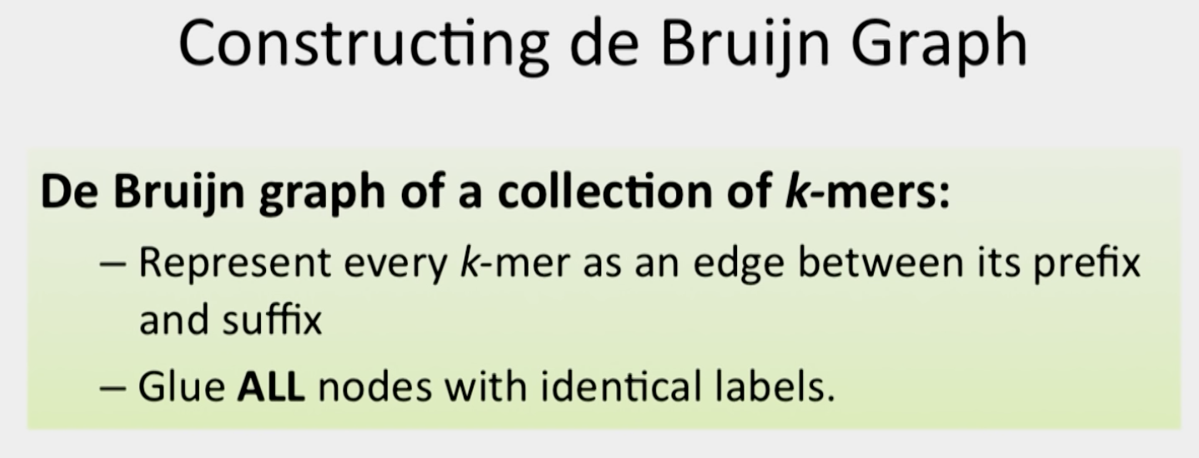
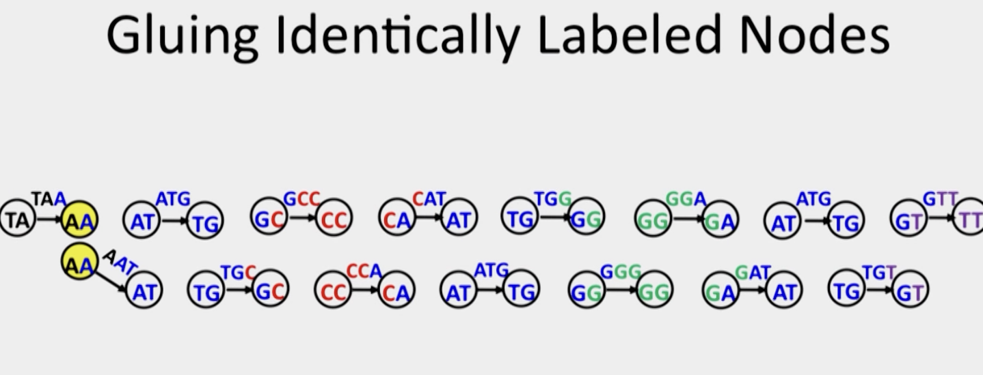
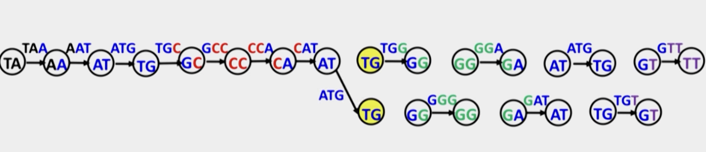
Why does Salmon need a transcriptome?

Slide 8
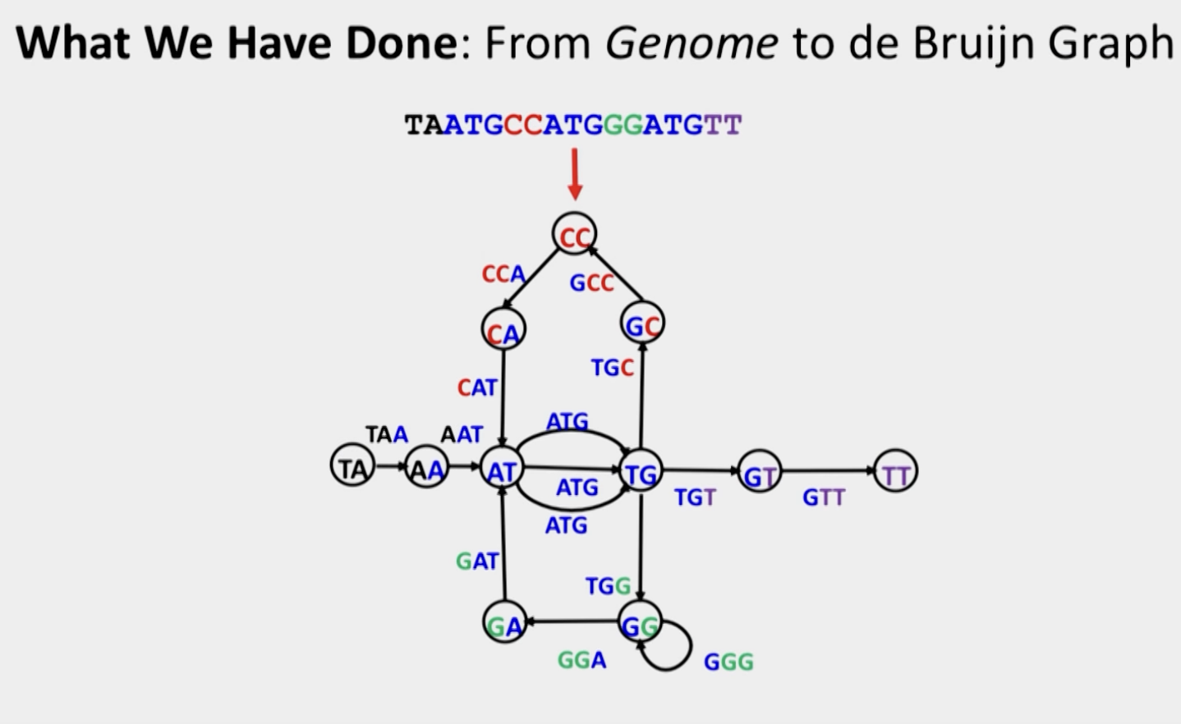
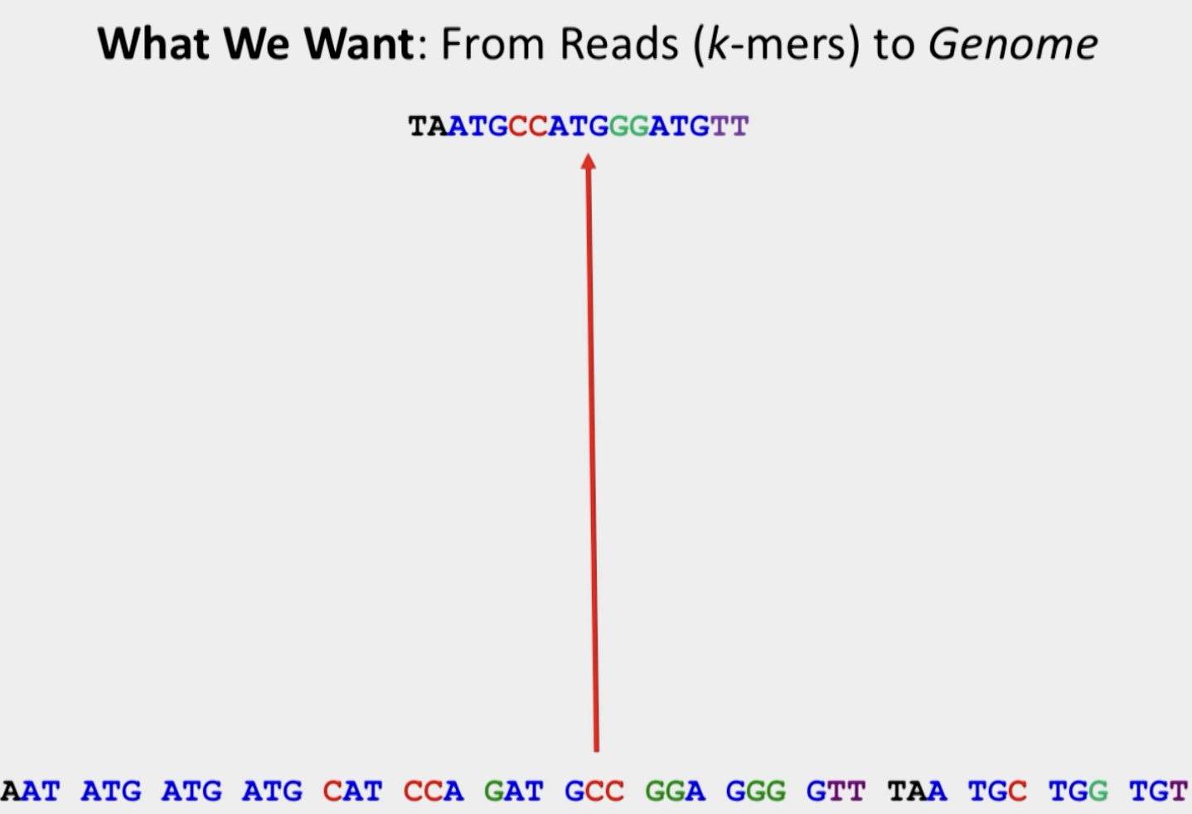
Why does Salmon need a transcriptome?

Slide 9
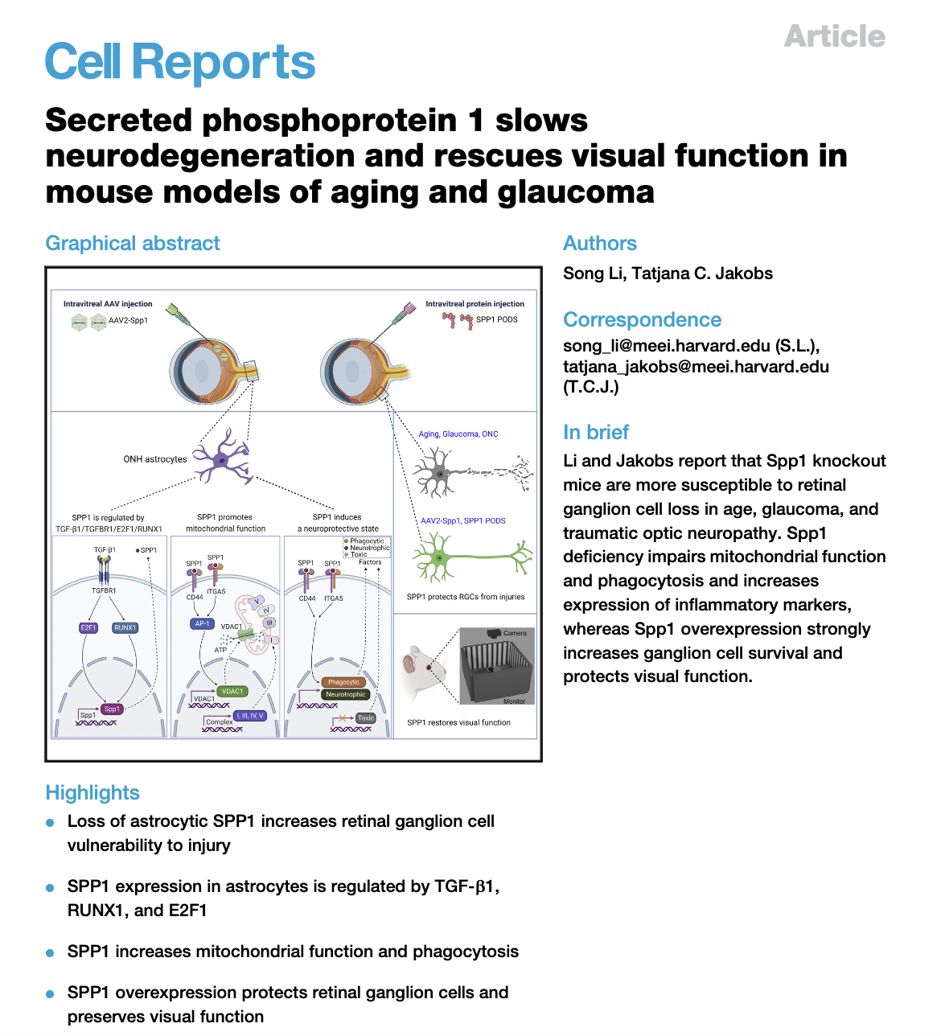
Dataset
Experimental design: Astrocytes mRNA profiles of wild type and Spp1 KO neonatal mice
Sequencing - Illumina NovaSeq 6000
Alignment (GRCm38) - STAR software package
Differential expression analysis - DESeq2
Results:
Reads obtained - 40 million raw reads per sample
DEGs - 3624 (fold change ≥1.5 and p value <0.05)
1991 were upregulated and 1633 were downregulated in the Spp1−/− astrocytes

Slide 10
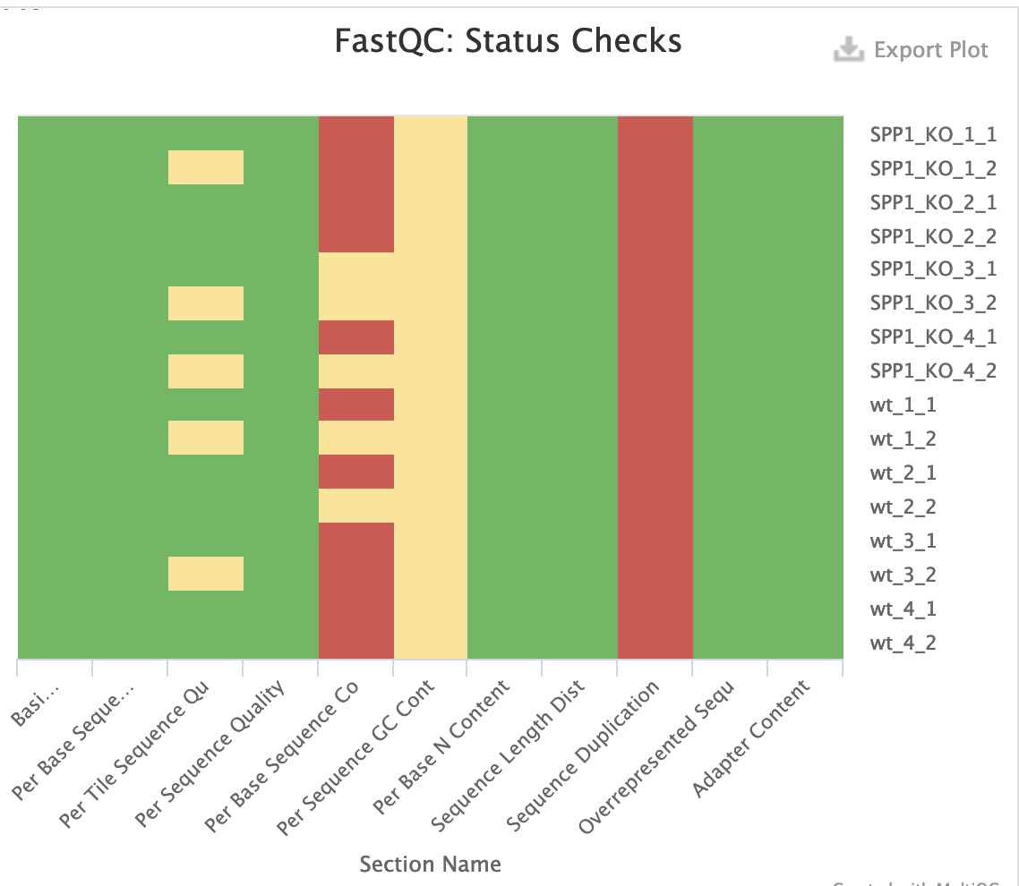
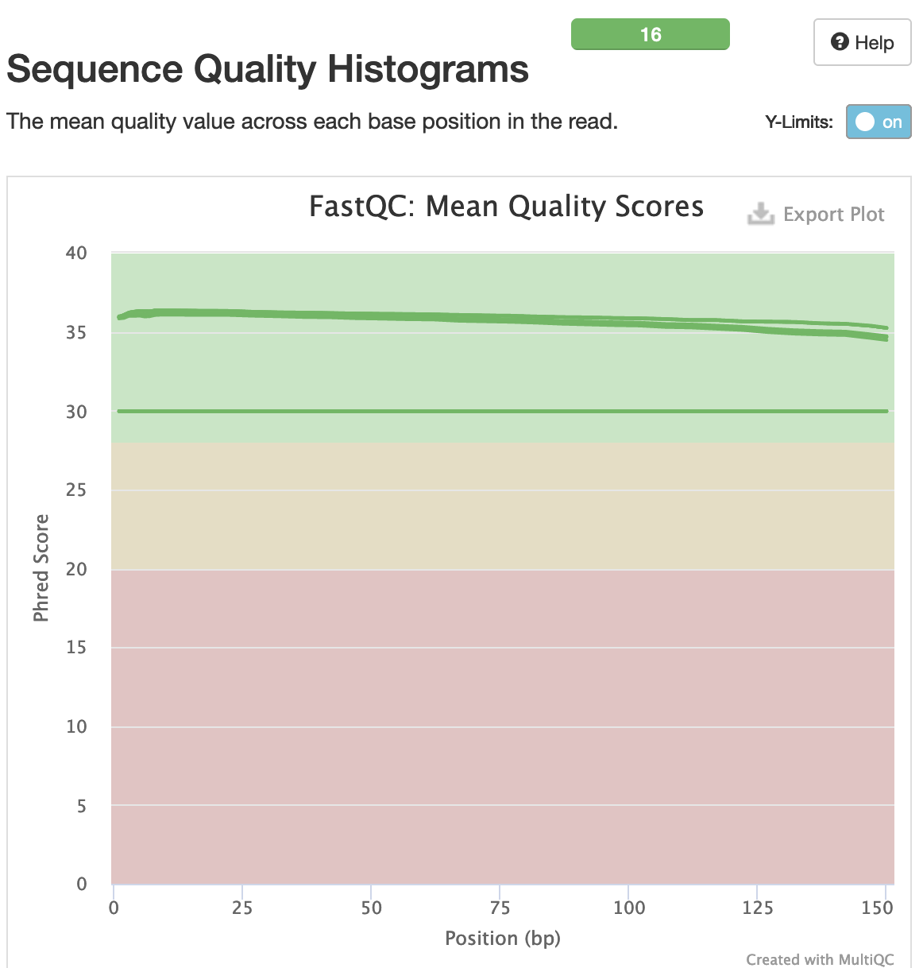
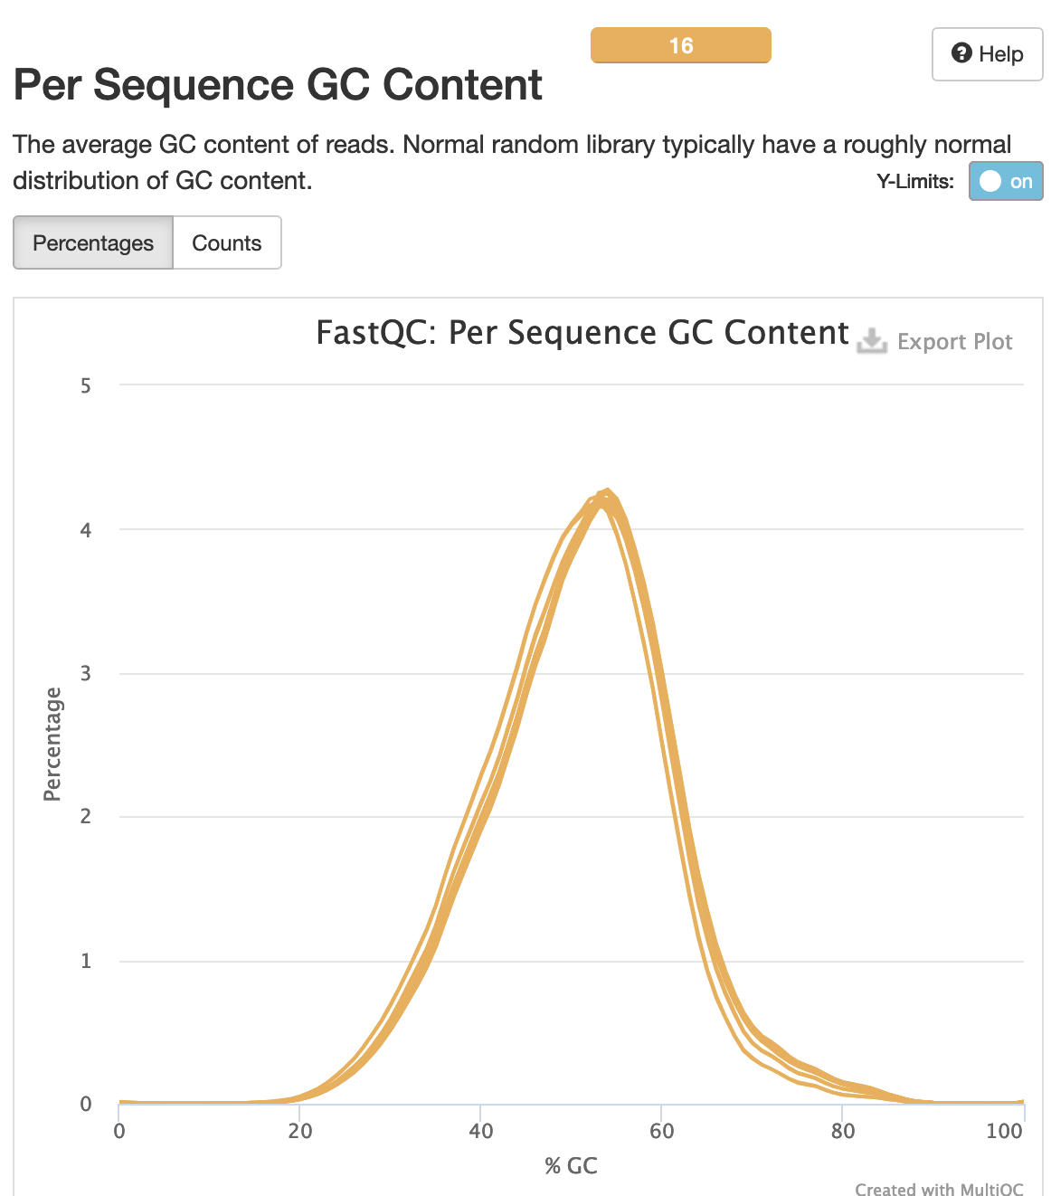
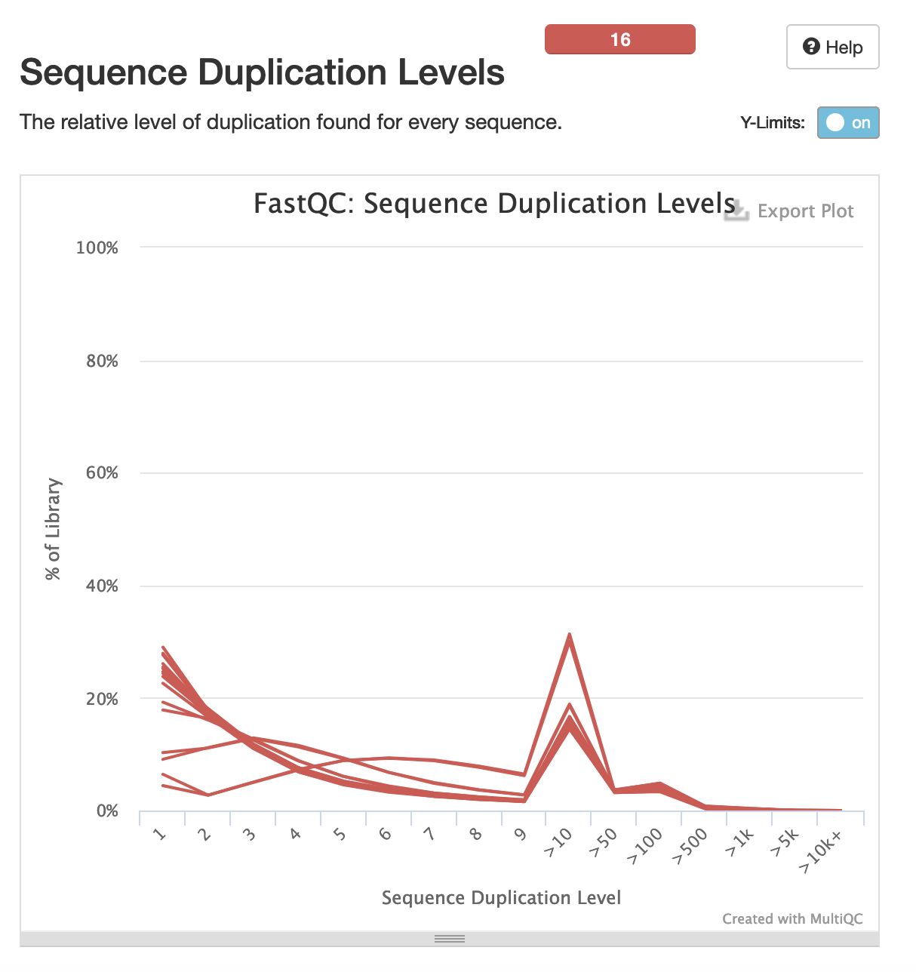
FASTQC

Slide 11
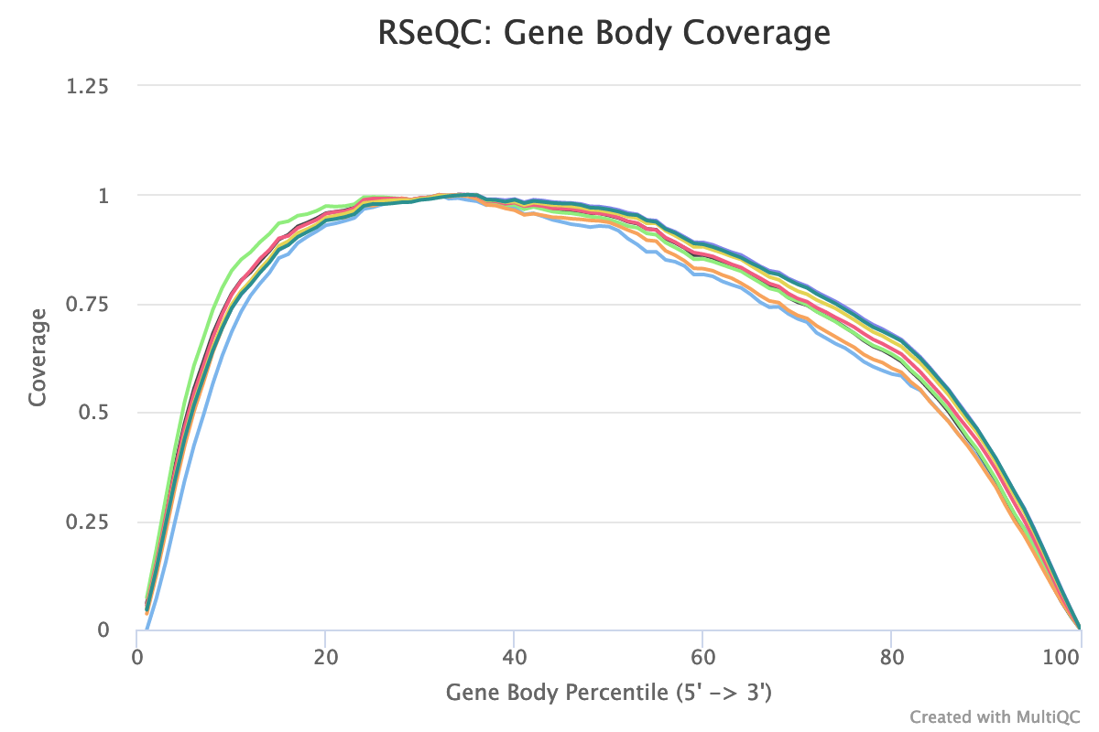
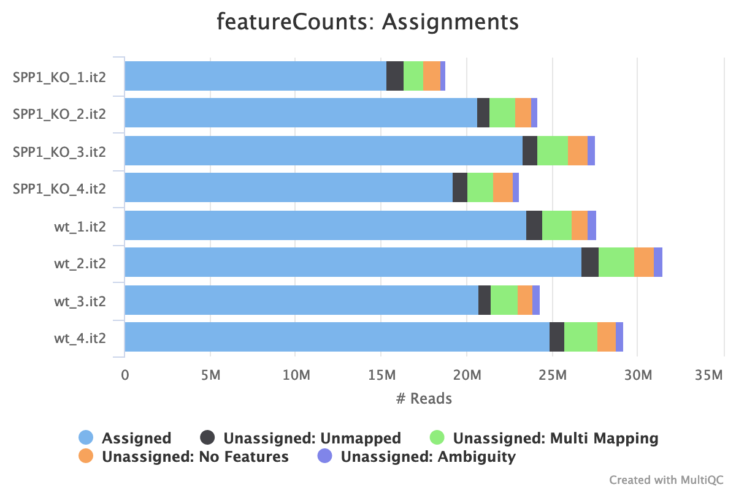
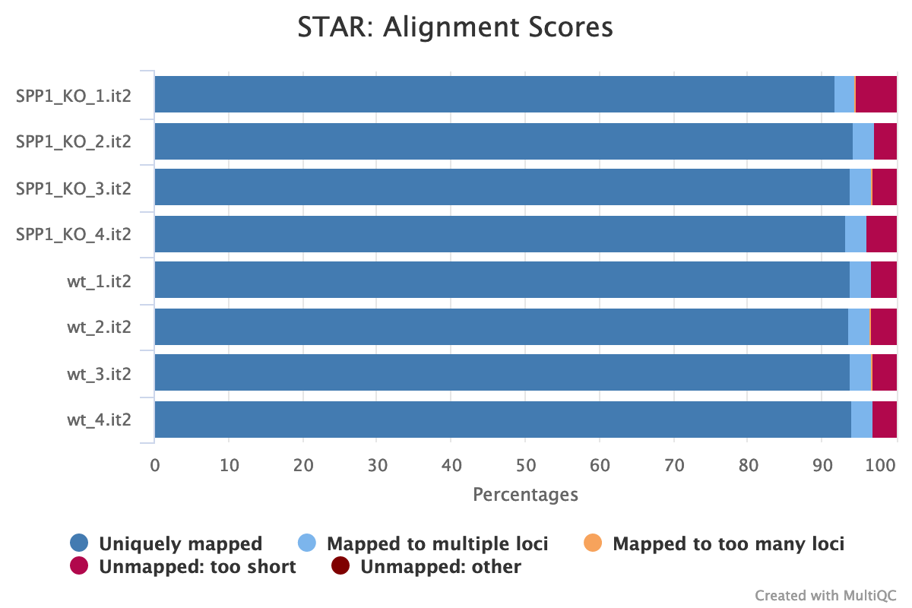
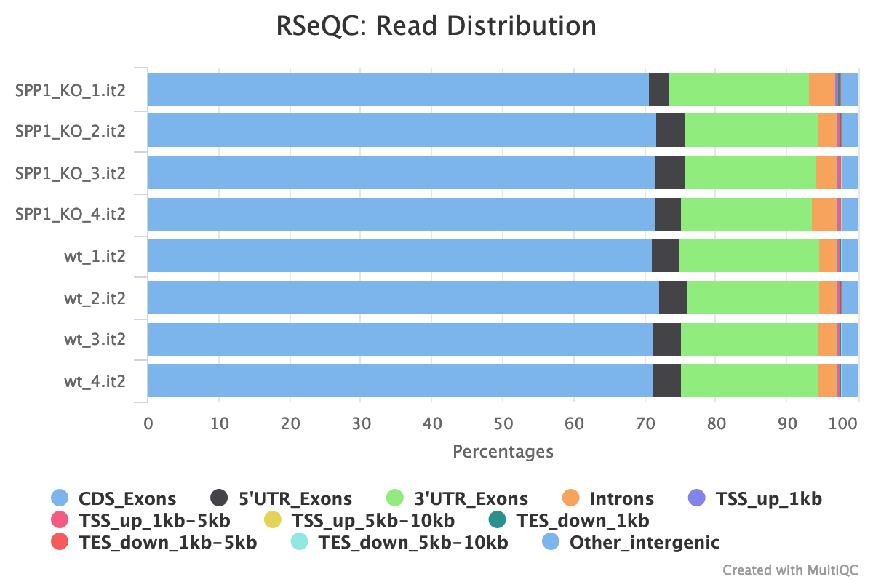
STAR Alignment QC

Slide 12
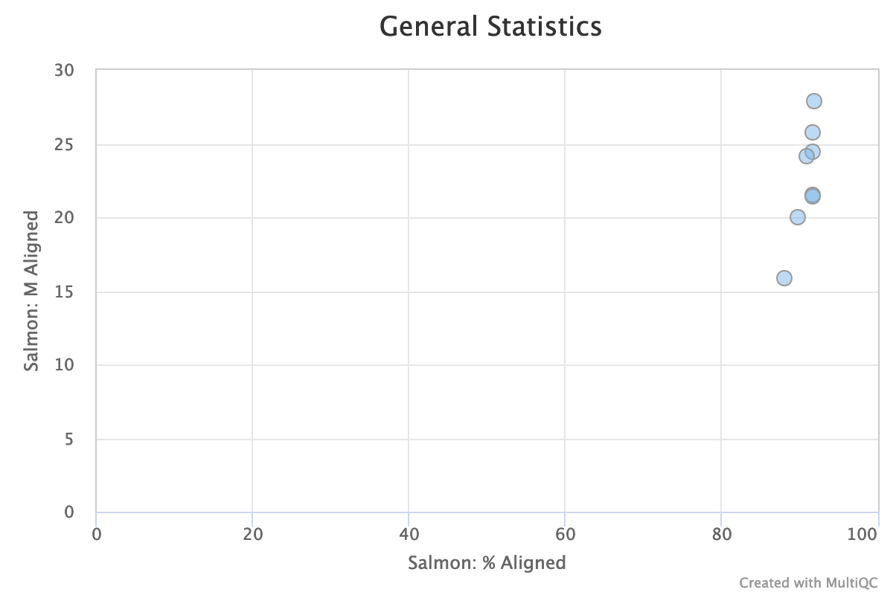
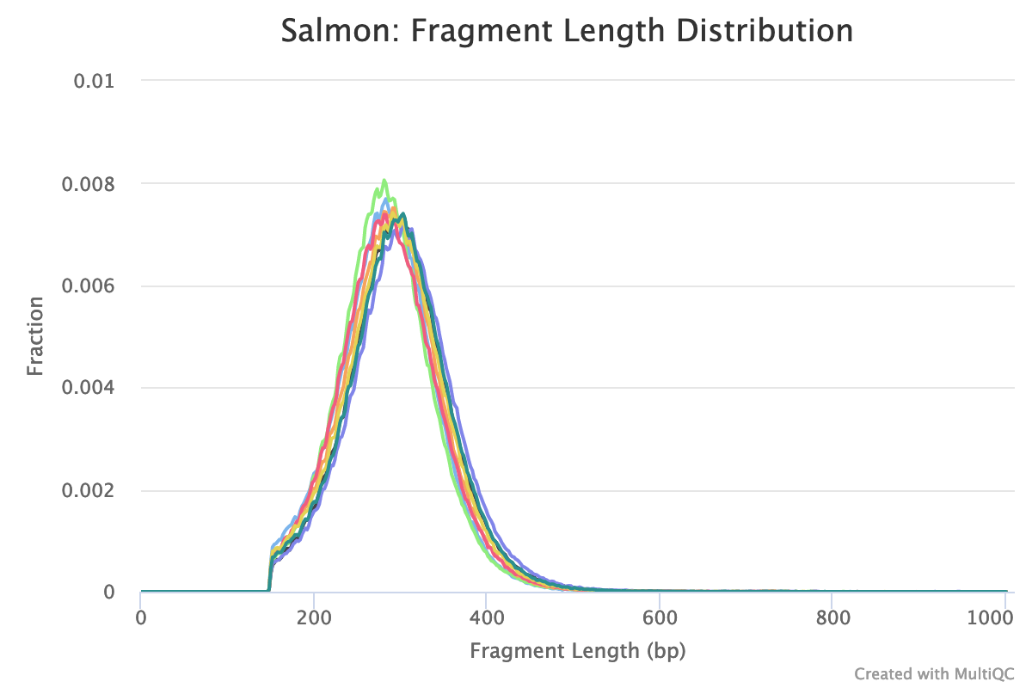
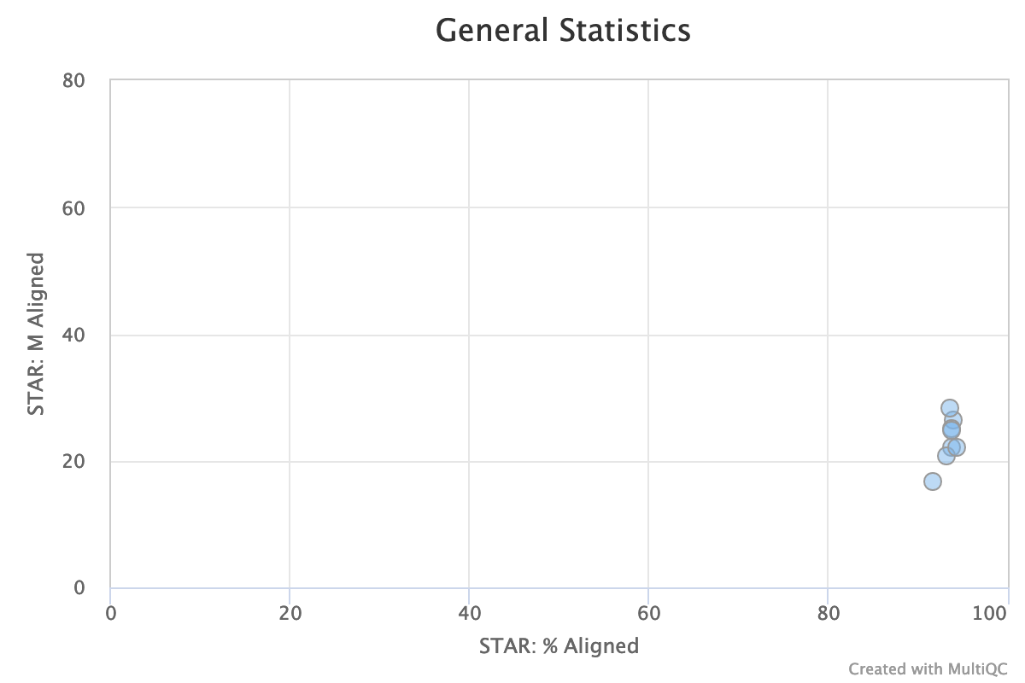
Salmon Quant QC

Slide 13
EDA

Slide 14
Results

Slide 15
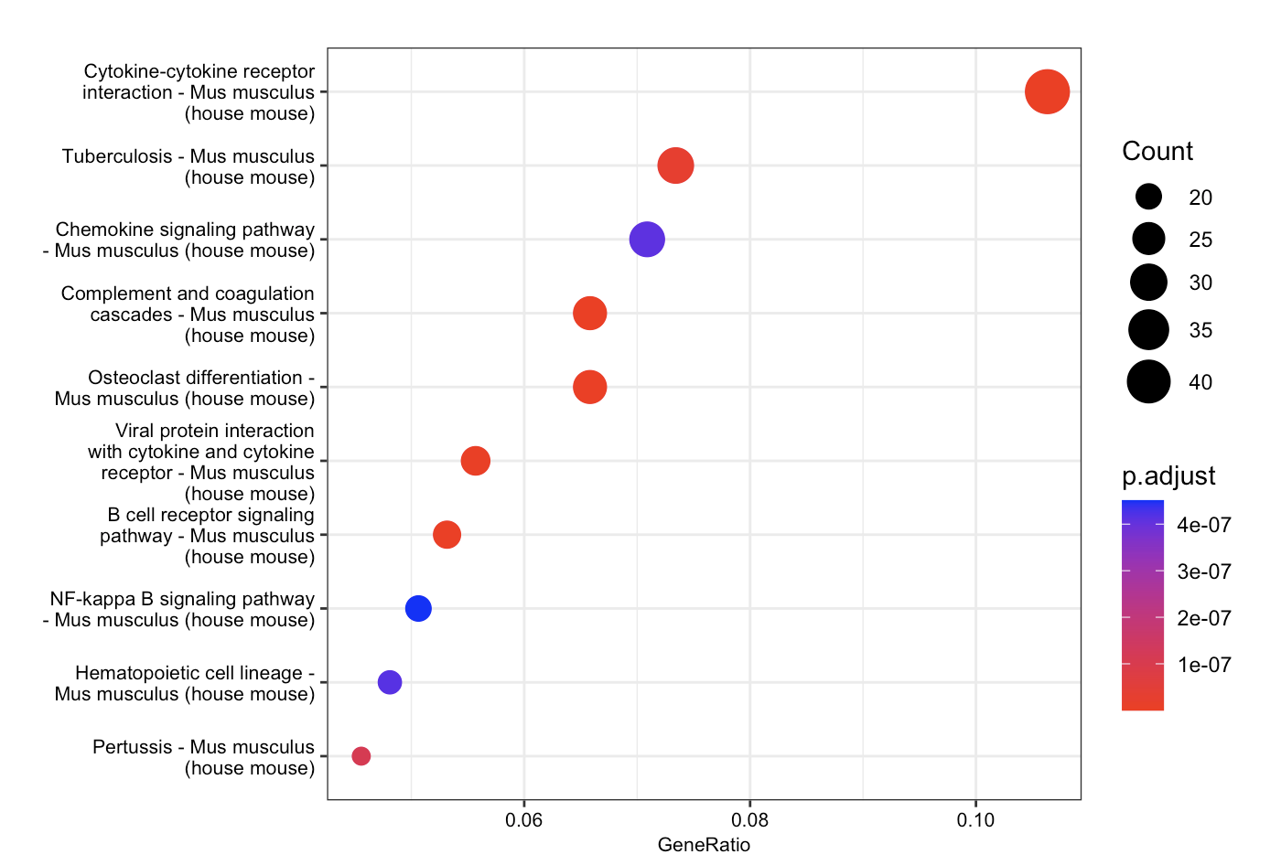
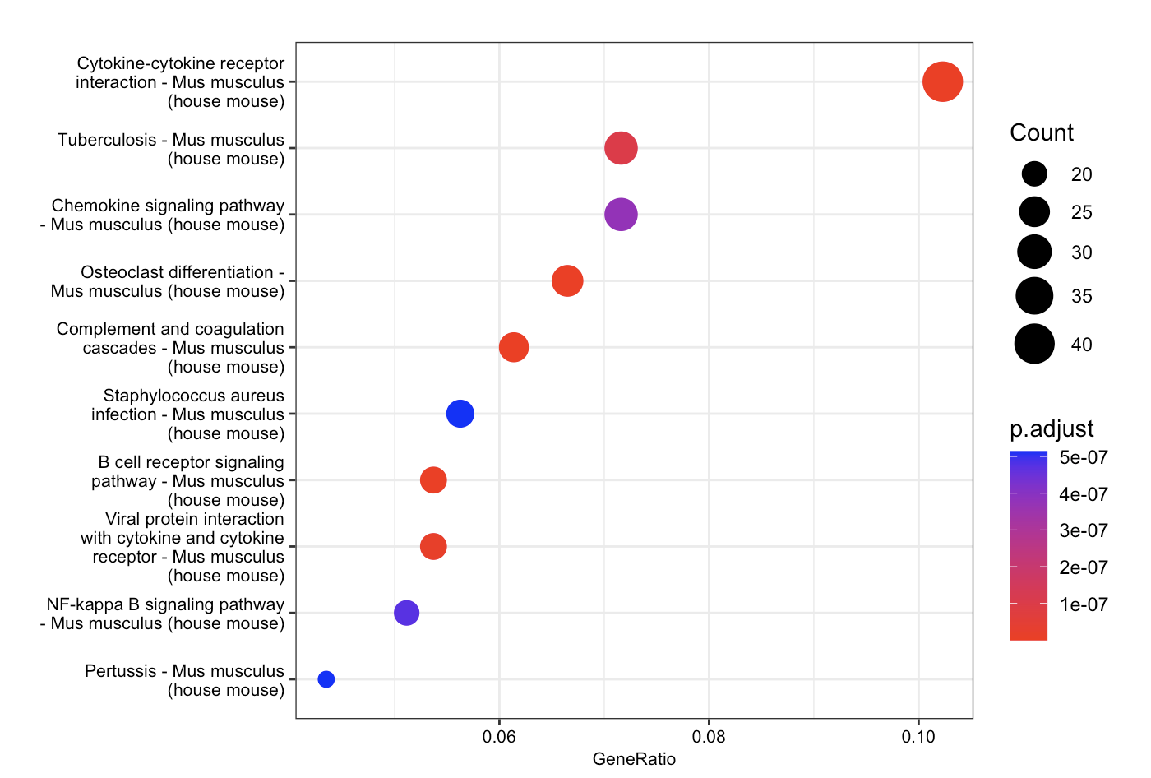
Results
Left: STAR Right: Salmon

Slide 16
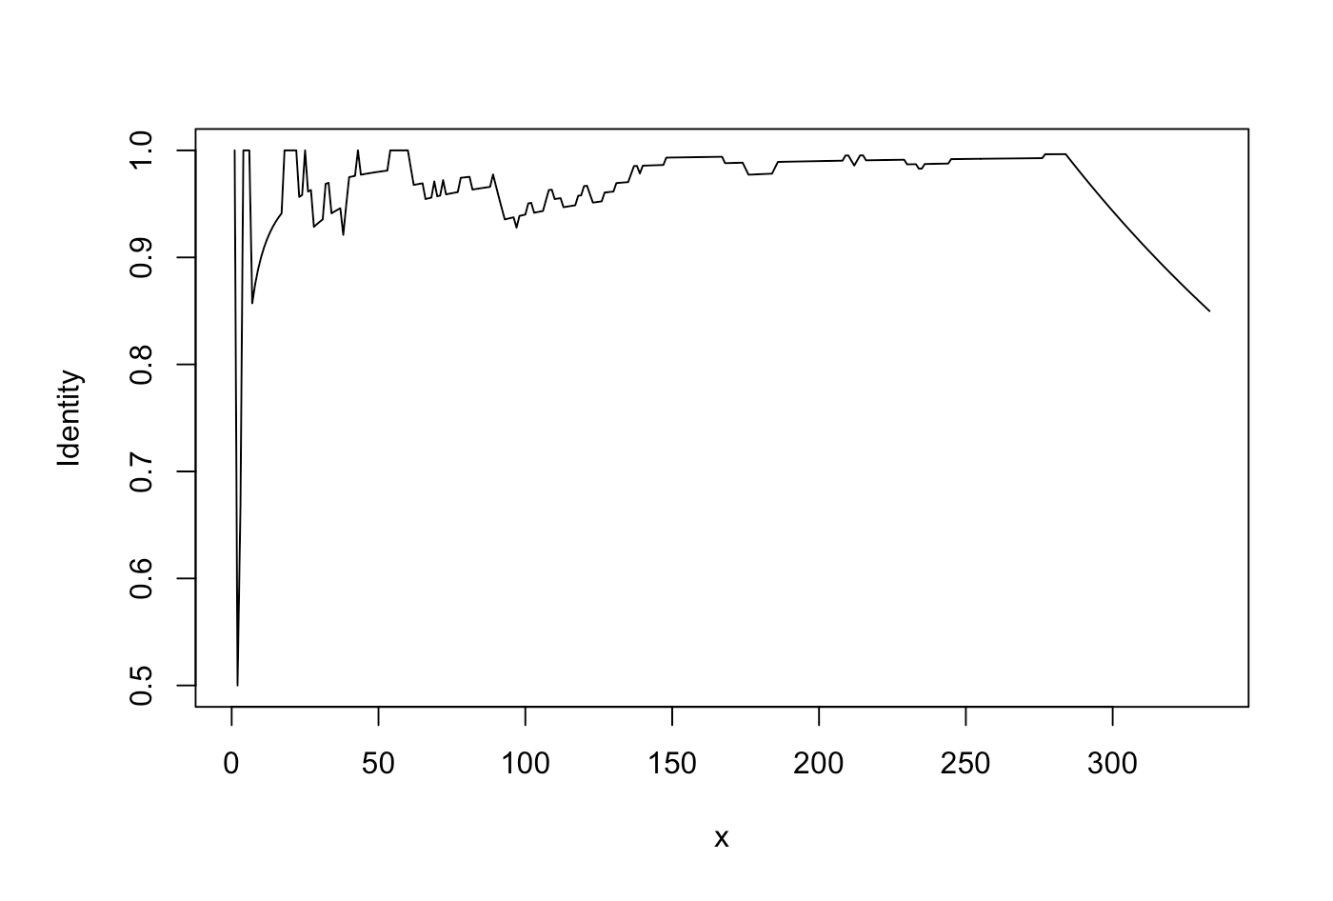
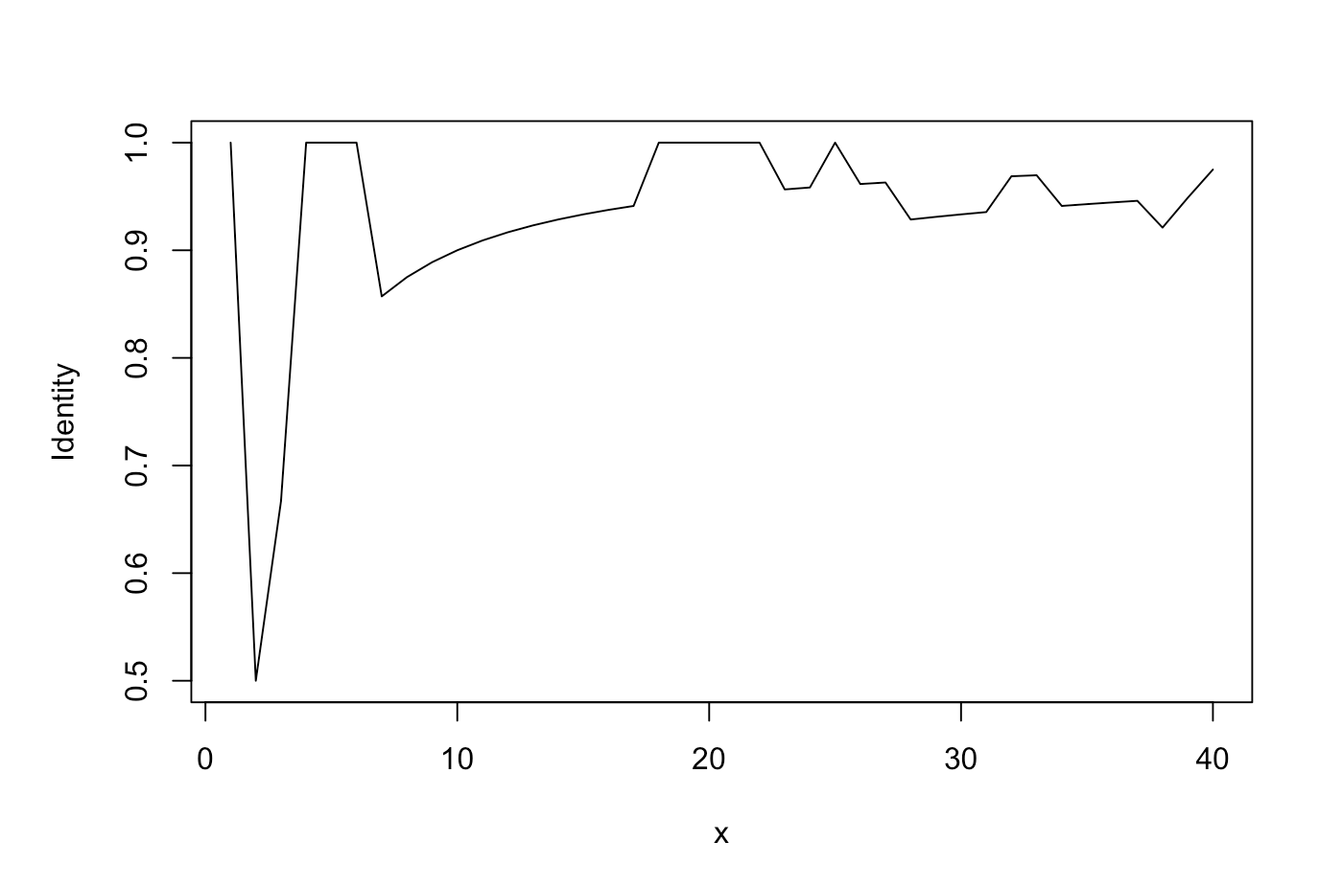
Results
Identity between STAR and Salmon Enriched pathways in the top x significant pathways

Slide 17
Discussion

Slide 18
Datasets

Slide 19
GitHub

Slide 20
References

